Slide 1
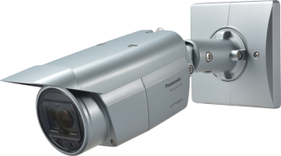
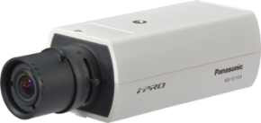
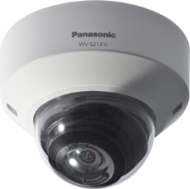
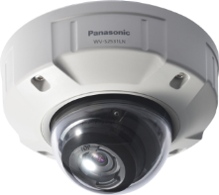

Fixed / Fixed dome cameras
Fixed Box : WV-S1131, WV-S1132, WV-S1111, WV-S1112
WV-S1531LN, WV-S1531LTN, WV-S1511LN
Fixed Dome : WV-S2131L, WV-S2131, WV-S2130, WV-S2111L, WV-S2110
WV-S2231L, WV-S2211L
WV-S2531LN, WV-S2531LTN, WV-S2511LN
Security Systems Business Division
Panasonic System Networks Co., Ltd.

Slide 2


Slide 3




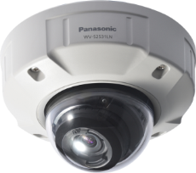
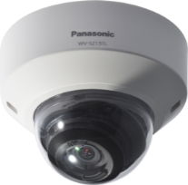
New Fixed cameras
Can capture clear images at any scene (Extreme Visibility )
Can reduce the recording capacity ( Extreme Compression )
Automatically adapts to your application scene,
(intelligent auto mode ).
Under very low lighting conditions, you can get the clear color images with Color night vision.
Even if the situation under backlight, keep your evidence (face) clear at door steps with Enhanced Super Dynamic, 144dB.
Can keep clear images with ClearSight cover, even if it is rain weather.
Can reduce the network bandwidth and the recorder disk space by H.265 compression.
By Smart coding Technology for new camera, can more reduce the network bandwidth and the recorder disk space.
Extreme Secure the stream / data
Protect the devices from cyber attacks
Prevention leakage of the data on communication network by SSL/TLS with CA certificate.
Prevention leakage of the video by the module meet FIPS140-2 level 1.
Even if tempering the data, can detect the video alteration with CA certificate.

Slide 4

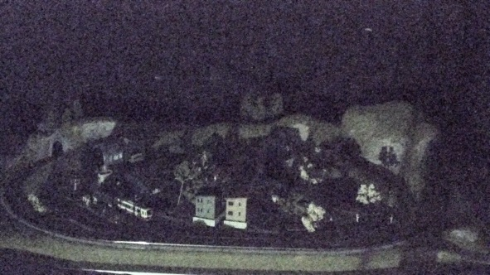
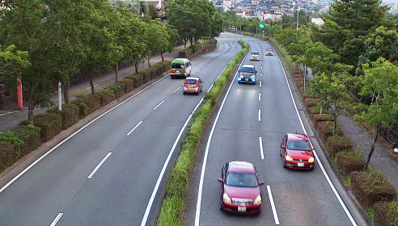

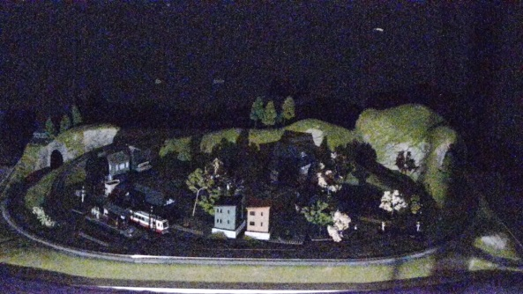
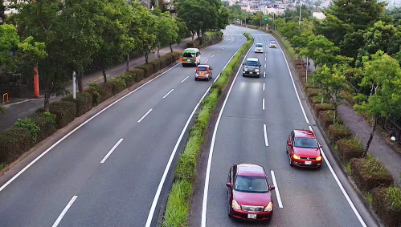

Extreme Visibility
Automatically adapts to your application scene, (intelligent auto ) mode
Clear color images with low light
Panasonic new night view enhancer technology changes your 1/3 inch sensor camera into a outstanding low light performance camera to provide you TRUE color information under very low lighting conditions.
Automatically optimizes camera parameters for best tuned image for various scenes, using techniques like Full Auto Shutter & Iris control, Backlit compensation , auto image stabilization.
Also can detect characteristics and movement within the scene to optimize camera settings to provide best fit picture quality.
0.1lux
WV-SPW531
Conventional model
new cameras, iA : ON
0.1lux,
new cameras

Slide 5
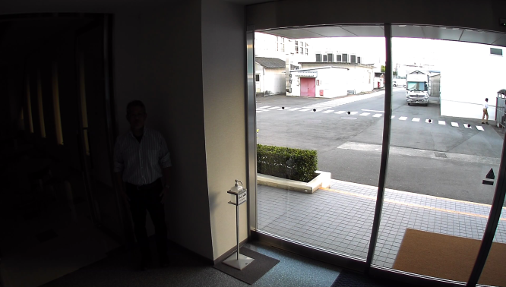
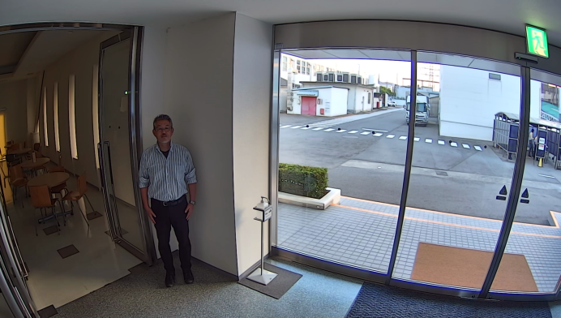
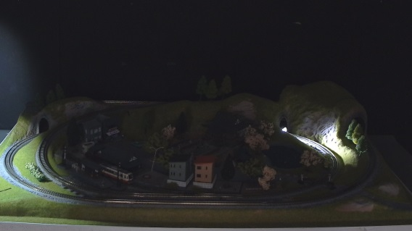
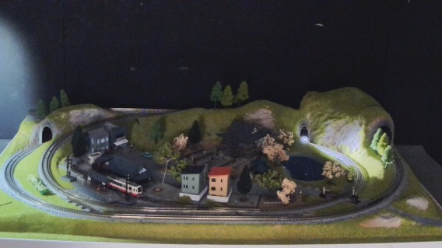

Extreme Visibility
Keep your evidence (face) clear at door steps
Day,
Super Dynamic : OFF
Combining high performance face detection technology inside the camera with the new 144dB enhanced Super Dynamic, keeps persons face at the most suitable lighting condition for better recognition. With variable exposure and shutter speed control, Enhanced Super Dynamic captures multiple images with optimal short and long exposures.
Best fit solutions at door steps, and on vehicle applications where backlit conditions are severe.
Night, Super Dynamic : ON
Day,
Super Dynamic : ON
Night, Super Dynamic : OFF

Slide 6
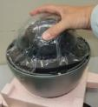
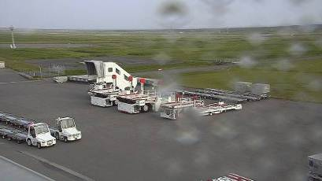
Extreme Visibility / Extreme Compression
Can keep clear images, even if it is rain weather
Higher H.265 compression
With the latest compression standard, these cameras save the network bandwidth and the recorder disk space, keeping high quality of images.
In addition, when using Smart Coding function, you can more save the network bandwidth and the recorder disk.
ClearSight coating significantly increases the operational utility of outdoor cameras in rain weather. The specially coated surface resists water stains and dust accumulation, reducing the need for periodic maintenance. This function is supported on WV-S1531LN, WV-S1511LN, WV-S2531LN and WV-S2511LN.
ClearSight Coating can be wiped with a damp cloth or washed with a neutral detergent.
Approx. -50%
Cameras | WV-SP509 | WV-SPN531A | WV-S1131
Full HD at 30fps | 4 Mbps | 3 Mbps ( -25%) | 2 Mbps (-30%)
Approx. -30%
CleaSight coating. For comparison, the right half is not coated.

Slide 7
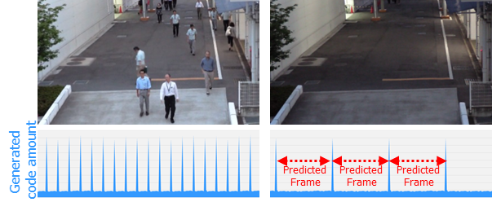
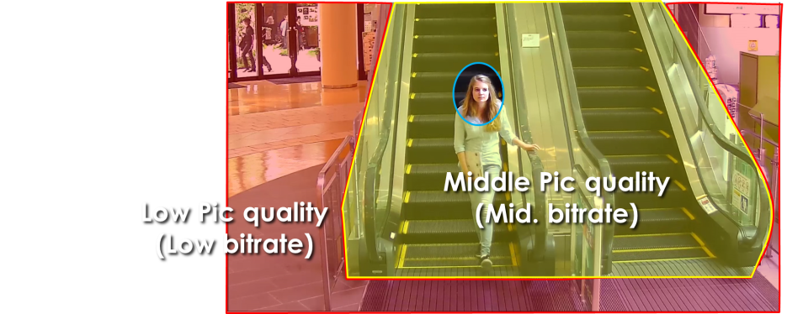
Extreme Compression
Smart coding Technology for New camera
With the latest bitrate reducing technology, GOP control, Auto-VIQS, Smart face coding, these cameras save the network bandwidth and the recorder disk space.
The cameras can reduce the amount of data by up to approx. 95% for still scene and up to approx. 80% for moving scene compared with the normal H.264 codec. When comparing with Panasonic H264 camera (WV-SPN531, SPN631 etc) , the amount of data is reduced by up to approx. 70% for moving scene and up to approx. 90% for still scene.
When people are walking, I-frame is inserted at regular intervals as usual.
When there is no person walking,
I-frames are thinned down to reduce the amount of data.
*The reduced bitrate ratio differs depending on each scene.
GOP control reduces encoding data by using p-frame in place of i-frame when no motion is detected.
Keep high
Pic quality
Scene | Without GOP | With GOP
Heavy traffic of people | 3 Mbps | 3 Mbps
Minimal traffic of people | 2 Mbps | 1 Mbps(-50 to - 60%)
Auto-VIQS can automatically determine areas with and without motion and reduce the data volume of those without motion.
The camera can also detect faces and keep the area of the face at most highest picture quality to keep your most important evidence to be kept clear, Smart facial coding.
*Simulated image

Slide 8

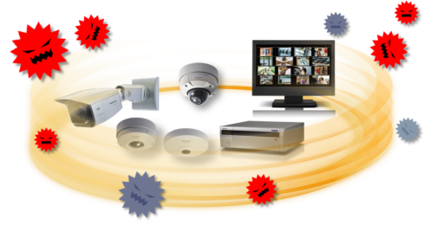

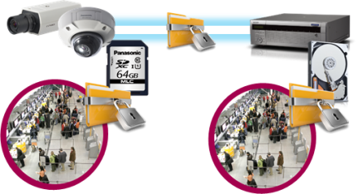


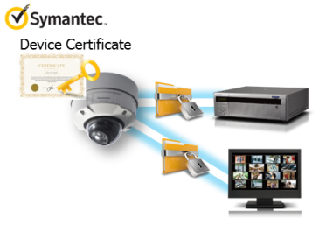
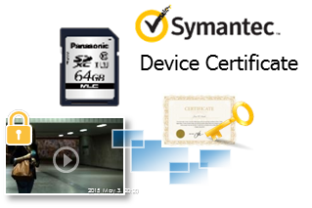
Extreme Secure
Protect the devices from cyber attacks
Prevention leakage of the video
Eliminated vulnerability with the latest CVE* support
*CVE : Common Vulnerabilities and Exposures. Common Vulnerabilities and Exposures is a dictionary of common names
(i.e., CVE Identifiers) for publicly known
Equipped with a SD memory card slot, the camera
stores encrypted videos locally. The data can be
password-protected and alteration detection helps ensure credibility of data.
The stream and video are encrypted by the module meet FIPS140-2 level 1. Panasonic fully protect the stream and the video on the End-to-End System.
Prevention leakage of the data on communication network
Realize secure communication between devices by using communication encryption (SSL/TLS communication).
By using Symantec certification and hash value, can detect Video alteration and confirm which camera created the video.

Slide 9
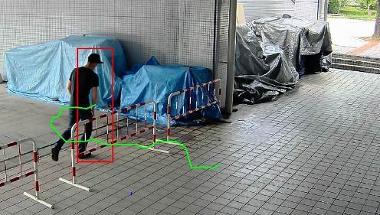
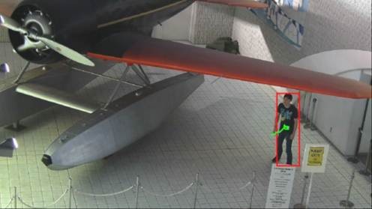
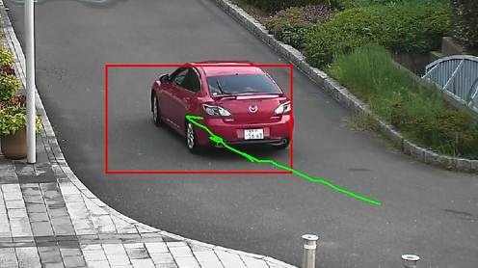
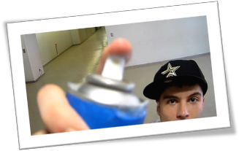
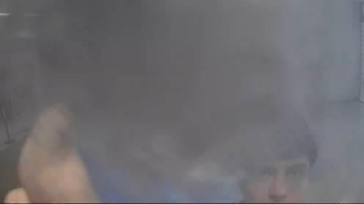
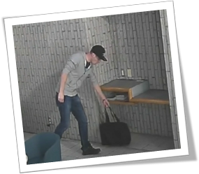
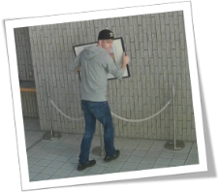
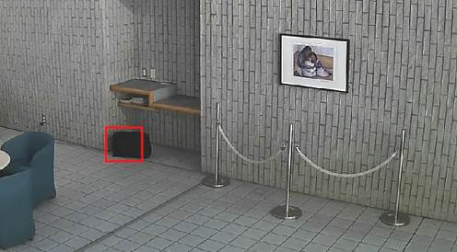
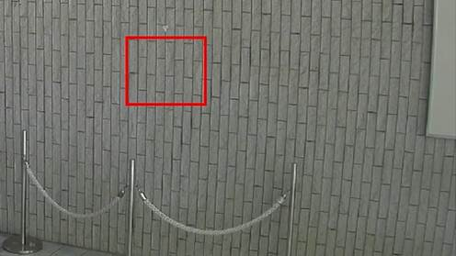
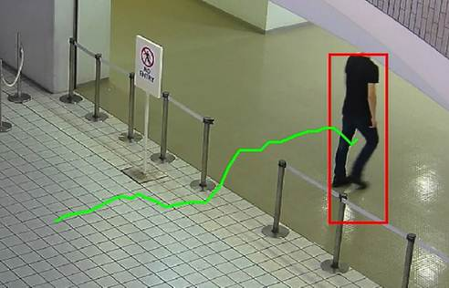
Optional intelligent VMD (i-VMD)
Intruder detection
detects people or cars trespassing in restricted areas.
Loitering detection
detects people who has loitered for too long in the area.
Direction detection
detects people or cars that go the wrong direction.
Scene change detection detects tampering with the camera view.
Object detection (left)
detects something left behind that shouldn’t be there.
Object detection (removed)
detects objects disappearing that should be present.
Cross line detection
detects people or objects crossing the imaginary lines.

Slide 10
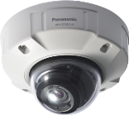
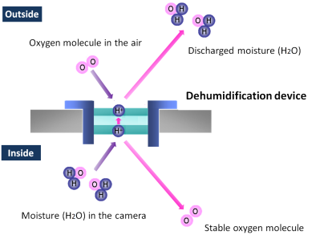
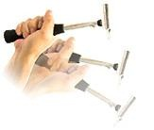
… and other useful features
Unbreakable, even if shocked externally
Clear images with low light or complete darkness by IR-LED
The vandal cameras (WV-S1531LN, WV-S1511LN,WV-S2231L, WV-S2211L,WV-S2531LN, WV-S2511LN) are IK10-rated impact resistant. In case the camera is subjected to mechanical shock, an impact-resistant
aluminum die-cast body protects
the optical system from the impact.
Equipped with F1.6 large diameter lens and high-sensitive sensor, the cameras can produce a color image with a minimum illumination less than 0.012 lux. And, the camera (WV-S1531LN, WV-S1511LN, WV-S2131L, WV-S2111L,
WV-S2231L, WV-S2211L, WV-S2531LN,
WV-S2511LN) have a built-in IR LED
to capture clear images in low light or
complete darkness.
Capture clear images, no matter what environment ;
IP66- and NEMA 4X-rated robustness
The outdoor cameras (WV-S1531LN, WV-S1511LN, WV-S2531LN, WV-S2511LN) support IP66- and NEMA 4X-rated weather resistant. The built-in electrical dehumidification keeps the camera dry inside, using electrolysis to remove any moisture from the camera. This anti-humidity technology is safe and green due to low power consumption and no heaters or
mechanical fans being used.

Slide 11
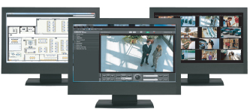
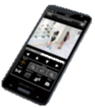
… and other useful features
Central management
The WV-ASM300 and System970 i-PRO management software enables central management of the cameras, recorders and monitors.
Viewing on smartphones and tablets
Panasonic Security Viewer enables viewing outside the surveillance center. It support only the H.264 mode of these cameras.
Alarm notification
When VMD, advanced auto tracking alarm, terminal alarm such as door alarm or command alarm is detected, the camera sends alarms to the operators based on pre-configured alert rule and/or saves images to FTP server.
Privacy masking
The camera supports electronic privacy masking. Zones, the masked areas of the image, are easily defined.

Slide 12
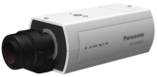
Specifications (Indoor Fixed Box)
 |  | WV-S1131 | WV-S1132 | WV-S1111 | WV-S1112
Type |  | Indoor
Image sensor |  | 1 / 2.8 type MOS
Max. video resolution (pixel) |  | 2048 x 1536 (Super resolution) |  | 1280x960
Max. frame rate |  | 60 fps
Day / Night |  | Yes (ICR)
Minimum Illumination | Color | 0.01lx @F1.4 |  | 0.007lx @F1.4
 | B/W | 0.004 lx@F1.4 |  | 0.003lx @F1.4
Lens mount |  | CS Mount
Angular Field of View *16:9 mode | Horizontal | Lens optional
 | Vertical
Audio |  | Two-way
SD memory card slot |  | 1slot (SDXC)
Ambient Operating Temperature |  | -10°C ~ +50°C (14 °F ~ 122 °F)
Dimension (W x H x D (mm), excluding base bracket) |  | 75 x 57 x 146
Area selling products as of Nov 2016 (North America, Europe, Russia, Latin America, Asia, Middle East Asia, South Africa) |  | all | except North America | except Europe | except North America, Europe

Slide 13
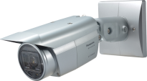
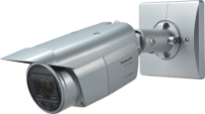

Specifications (Outdoor Fixed Box)
 |  | WV-S1531LTN | WV-S1531LN | WV-S1511LN
Type |  | Outdoor
Image sensor |  | 1 / 3 type MOS
Max. video resolution (pixel) |  | 2048 x 1536 (Super resolution) |  | 1280x960
Max. frame rate |  | 60 fps
Day / Night |  | Yes (ICR)
Minimum Illumination | Color | 0.015lx @F1.7 | 0.012lx @F1.6 | 0.008lx @F1.6
 | B/W | 0.0lx @F1.6 with IR-LED
Built –in IR LED irradiation distance |  | Approx. 40m (131ft.)
Vari Focal Length |  | 9.0 – 21 mm | 2.8 - 10 mm
Angular Field of View *16:9 mode | Horizontal | 14°(Tele) - 34°(Wide) | 31°(Tele) - 112°(Wide)
 | Vertical | 8°(Tele) - 19°(Wide) | 17°(Tele) - 60°(Wide)
Audio |  | Two-way
SD memory card slot |  | 1slot (SDXC)
Ambient Operating Temperature |  | IR-LED ON : -40°C ~ +50°C (-40 °F ~ 122 °F) IR-LED OFF : -40°C ~ +60°C (-40 °F ~ 140 °F)
Dimension (W x H x D (mm), excluding base bracket) |  | 95 x 99 x 337
Area selling products (North America, Europe, Russia, Latin America, Asia, Middle East Asia, South Africa) |  | all |  | except Europe

Slide 14
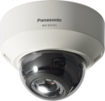
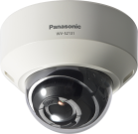

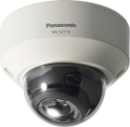

Specifications (Indoor Fixed Dome)
 |  | WV-S2131L | WV-S2131 | WV-S2130 | WV-S2111L | WV-S2110
Type |  | Indoor
Image sensor |  | 1 / 3 type MOS
Max. video resolution (pixel) |  | 2048 x 1536 (Super resolution) |  |  | 1280 x 960
Max. frame rate |  | 60 fps
Day / Night |  | Yes (ICR) |  | Yes (Electrical) | Yes (ICR) | Yes (Electrical)
Minimum Illumination | Color | 0.012lx @F1.6 |  |  | 0.008 lx @F1.6
 | B/W | 0.0lx @F1.6 with IR-LED | 0.006lx @F1.6 | 0.01lx @F1.6 | 0.0lx @F1.6 with IR-LED | 0.004lx @F1.6
Built –in IR LED irradiation distance |  | Approx. 30m (98ft.) | - |  | Approx. 30m (98ft.) | -
Vari Focal Length |  | 2.8 - 10 mm
Angular Field of View *16:9 mode | Horizontal | 30°(Tele) - 110°(Wide)
 | Vertical | 17°(Tele) - 59°(Wide)
Audio |  | Two-way |  | Mic only | Two-way | Mic only
SD memory card slot |  | 1slot (SDXC) |  | - | 1slot (SDXC) | -
Ambient Operating Temperature |  | -10°C ~ +50°C (14 °F ~ 122 °F)
Dimension (mm) |  | Φ129.5 x 101 (H)
Area selling products as of Nov 2016 (North America, Europe, Russia, Latin America, Asia, Middle East Asia, South Africa) |  | all | except North America | except North America, Europe | except Europe | except Europe

Slide 15
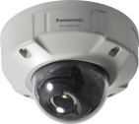
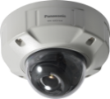

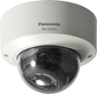
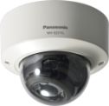
Specifications (Outdoor/Indoor vandal)
 |  | WV-S2531LTN | WV-S2531LN | WV-S2511LN | WV-S2231L | WV-S2211L
Type |  | Outdoor Vandal |  |  | Indoor Vandal
Image sensor |  | 1 / 3 type MOS
Max. video resolution (pixel) |  | 2048 x 1536 (Super resolution) |  | 1280 x 960 | 2048 x 1536 (Super resolution) | 1280 x 960
Max. frame rate |  | 60 fps
Day / Night |  | Yes (ICR)
Minimum Illumination | Color | 0.015lx @F1.7 | 0.012lx @F1.6 | 0.008 lx @F1.6 | 0.012lx @F1.6 | 0.008 lx @F1.6
 | B/W | 0.0lx @F1.6 with IR-LED
Built –in IR LED irradiation distance |  | Approx. 40m (131ft.) |  |  | Approx. 30m (98ft.)
Vari Focal Length |  | 9.0 – 21 mm | 2.8 - 10 mm
Angular Field of View *16:9 mode | Horizontal | 14°(Tele) - 34°(Wide) | 30°(Tele) - 108°(Wide) |  | 30°(Tele) - 109°(Wide)
 | Vertical | 8°(Tele) - 19°(Wide) | 17°(Tele) - 58°(Wide) |  | 17°(Tele) - 58°(Wide)
Audio |  | Two-way
SD memory card slot |  | 1slot (SDXC)
Ambient Operating Temperature |  | IR-LED ON : -40°C ~ +50°C (-40 °F ~ 122 °F) IR-LED OFF : -40°C ~ +60°C (-40 °F ~ 140 °F) |  |  | -10°C ~ +50°C (14 °F ~ 122 °F)
Dimension (mm) |  | Φ164 x 139 (H) |  |  | Φ129.5 x 102.5 (H)
Area selling products (North America, Europe, Russia, Latin America, Asia, Middle East Asia, South Africa) |  | all |  | except Europe | all | except Europe

Slide 16
Specifications (Outdoor/Indoor vandal)
 |  | WV-S2531LN | WV-S2511LN | WV-S2231L | WV-S2211L
Type |  | Outdoor Vandal |  | Indoor Vandal
Image sensor |  | 1 / 3 type MOS
Max. video resolution (pixel) |  | 2048 x 1536 (Super resolution) | 1280 x 960 | 2048 x 1536 (Super resolution) | 1280 x 960
Max. frame rate |  | 60 fps
Day / Night |  | Yes (ICR)
Minimum Illumination | Color | 0.012lx @F1.6 | 0.008 lx @F1.6 | 0.012lx @F1.6 | 0.008 lx @F1.6
 | B/W | 0.0lx @F1.6 with IR-LED
Built –in IR LED irradiation distance |  | Approx. 40m (131ft.) |  | Approx. 30m (98ft.)
Vari Focal Length |  | 2.8 - 10 mm
Angular Field of View *16:9 mode | Horizontal | 30°(Tele) - 108°(Wide) |  | 30°(Tele) - 109°(Wide)
 | Vertical | 17°(Tele) - 58°(Wide) |  | 17°(Tele) - 58°(Wide)
Audio |  | Two-way
SD memory card slot |  | 1slot (SDXC)
Ambient Operating Temperature |  | IR-LED ON : -40°C ~ +50°C (-40 °F ~ 122 °F) IR-LED OFF : -40°C ~ +60°C (-40 °F ~ 140 °F) |  | -10°C ~ +50°C (14 °F ~ 122 °F)
Dimension (mm) |  | Φ164 x 139 (H) |  | Φ129.5 x 102.5 (H)
Area selling products as of Nov 2016 (North America, Europe, Russia, Latin America, Asia, Middle East Asia, South Africa) |  | all | except Europe | all | except Europe

Slide 17
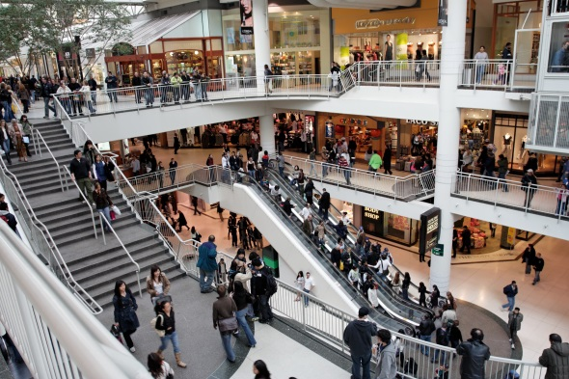
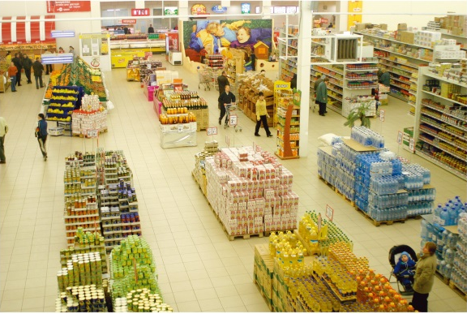
Applications
These cameras are suitable under the extreme conditions :
City Surveillance
Intersections
Airport
Stations
Port facilities
Plant
Shopping Malls and more.

Slide 18
i-Pro Extreme product naming structure
(cameras released at Oct, 2016 or later)
1 | ２ | ３ | ４ | ５ | ６ | ７ | ８ | 9 | 10 | 11 | 12
W | V | - | S | ２ | 5 | 3 | 1 | L | T | N
 |  |  | Series | Form | Environment | Resolution | Serial number | Other features |  | Minor Change | Region (J/H)
 |  |  | X:Hi-end S:Standard | 9：- 8：- 7：PTZ(Aero) 6：PTZ(Dome) 5：PT 4：360 deg. 3：Compact DOME 2：Dome 1：Box 0 : - | 9：- 8：- 7：- 6：- 5：Outdoor Vandal 4：Outdoor normal 3：- 2：Indoor Vandal 1：Indoor normal 0：- | 9：- 8 :6K(24MP) 7 :4K (12MP) 6 : 5 :5MP 4： 3 :FHD 2 : 1 :HD 0 :- | 9 : 8 : 7 : 6 : 5 : 4 : 3 : 2 : 1 : 0： | L : LED N: ClearSight M: M12 W: Wireless F : Optical I/F V : With lens T : Long focal lens K : Fix lens |  | D : C : B : A :

